Slide 1

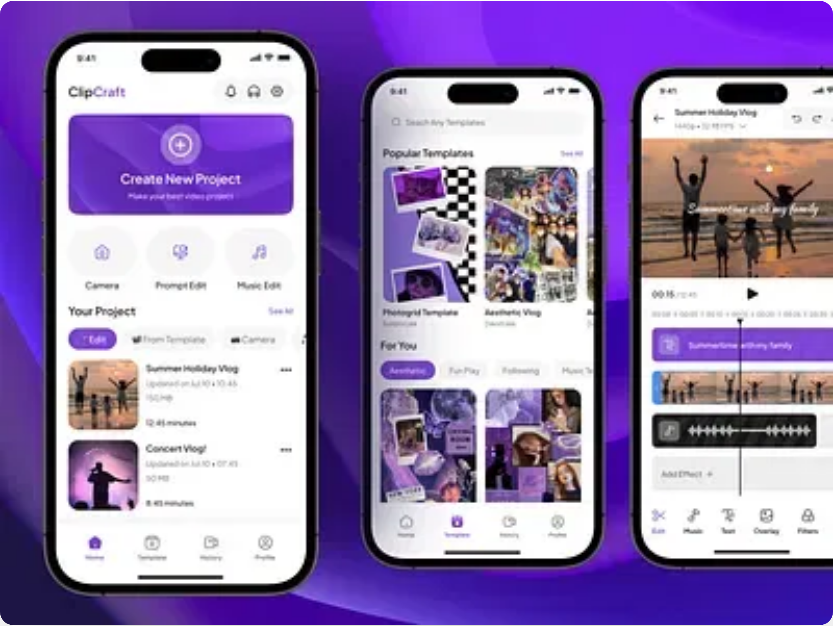
SnapEdit AI
Shoot. Speak. Sparkle. Go viral in under 60 seconds.
AI-Powered Video Editor for Short-Form Content
Investor Pitch Deck | 2025

Slide 2

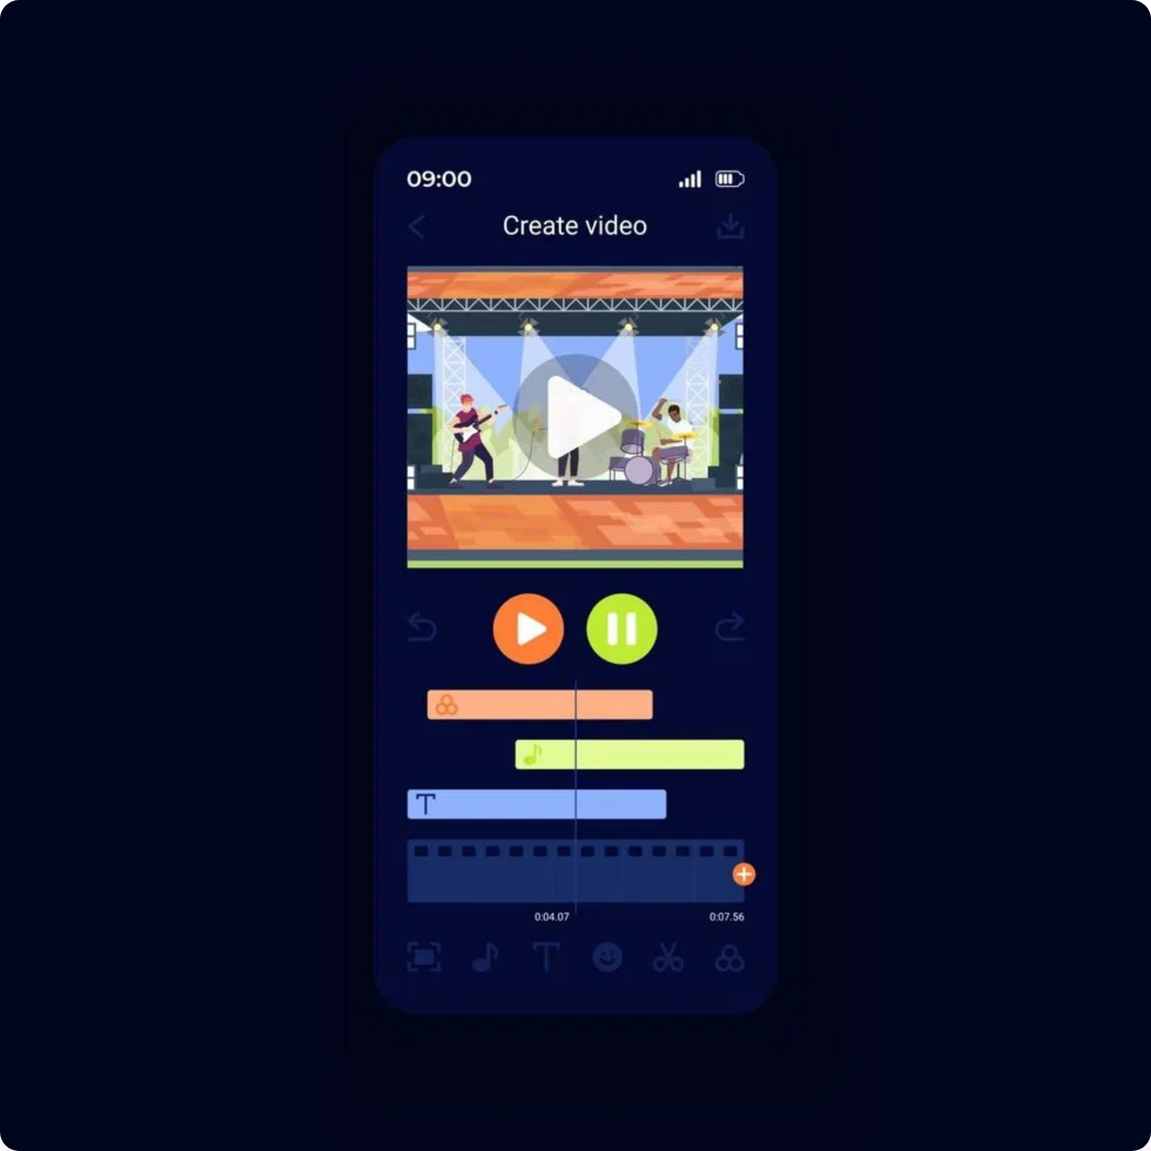




The Problem
Editing short-form video is still...
Time-Consuming
Creators spend 3-4 hours editing for every 1 minute of published content
Technically Complex
Professional-quality editing requires steep learning curves and expensive software
Not Optimized for Virality
Current tools don't incorporate trending styles or platform-specific optimization
Poor Mobile Experience
Mobile editing apps lack professional features or have clunky interfaces
2

Slide 3






Our Solution
Introducing
SnapEdit AI
An AI-powered video editor that automates 80% of the creative process, turning raw footage into viral-ready content in seconds.
Time-Saving Automation
Smart trimming, auto jump cuts, and AI-powered captions reduce editing time by 70%
No Technical Skills Required
Intuitive interface with AI assistance makes professional editing accessible to everyone
Viral-First Design
Templates and effects optimized for TikTok, Reels, and Shorts engagement algorithms
Mobile-Native Experience
Full-featured editing power in a streamlined mobile app designed for creators on the go
3

Slide 4

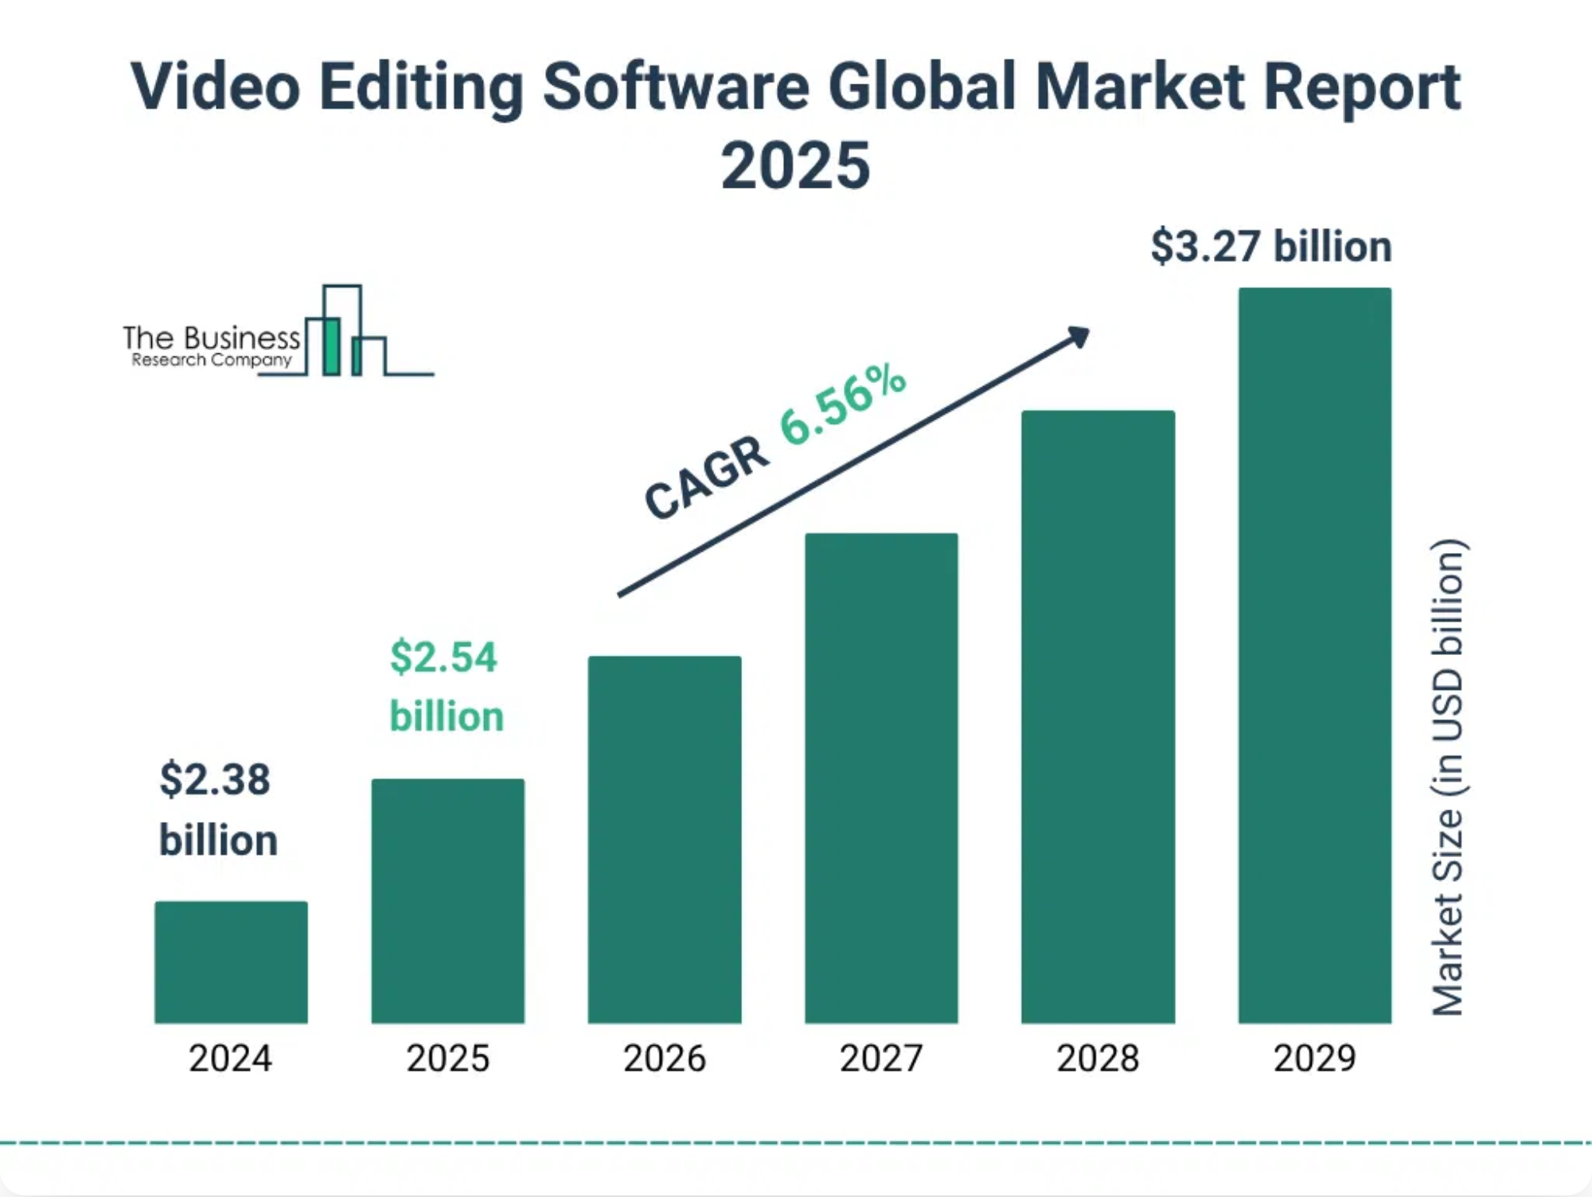




Market Opportunity
Video Editing Market Size (2024)
Projected CAGR
6.56%
$2.38B
AI in Video Editing Growth
17.2%
Annual growth rate through 2030
Target Audience
Gen Z Creators
Ages 16-24, mobile-first content creators
Micro-Influencers
10K-100K followers, high engagement rates
Small Businesses
Direct-to-consumer brands using social media
Content Repurposers
Podcasters, streamers converting to short-form
4

Slide 5



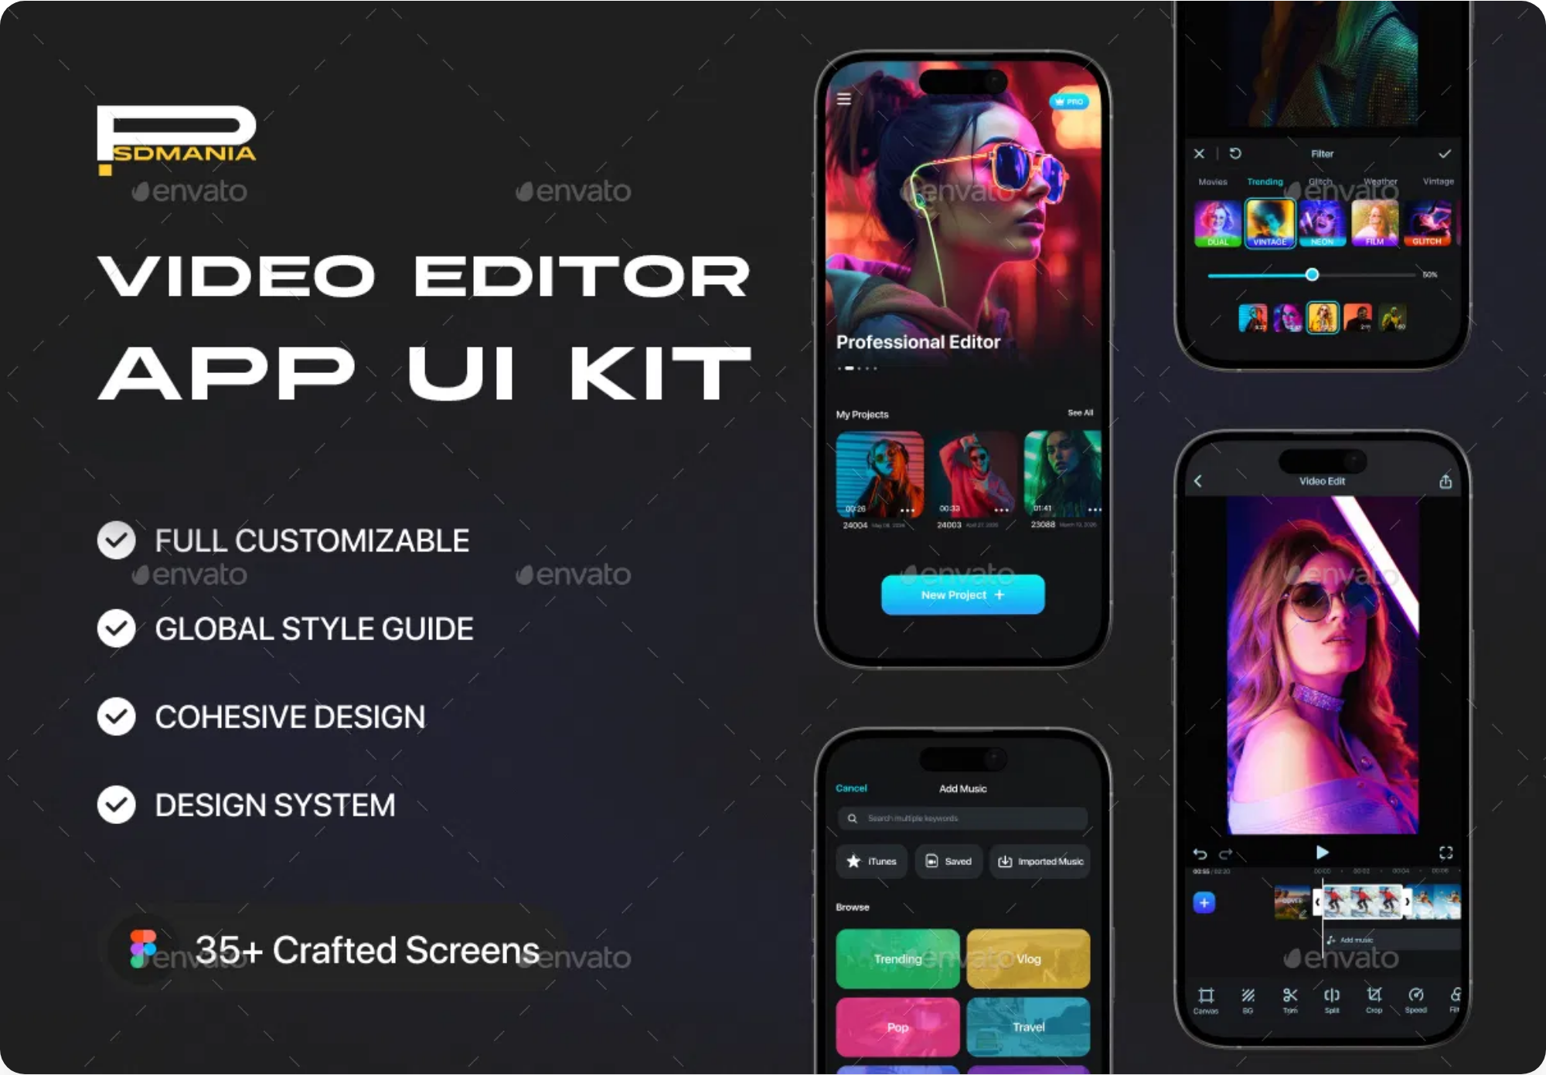


Product Features
Auto-Editing Pipeline
AI Features
Smart trimming detects key moments
AI-powered viral-style captions
AI speaker detection highlights each person
Voice-to-video script generation
Auto jump cut removes pauses and "ums"
AI avatars and visual filters
Viral-First Filters & Effects
Export & Publish
One-tap export to all platforms
Real-time TikTok/Reels style transitions
Schedule with best-time AI suggestion
Templates for trending content formats
Platform-specific optimization
Music hooks auto-synced to video
5

Slide 6


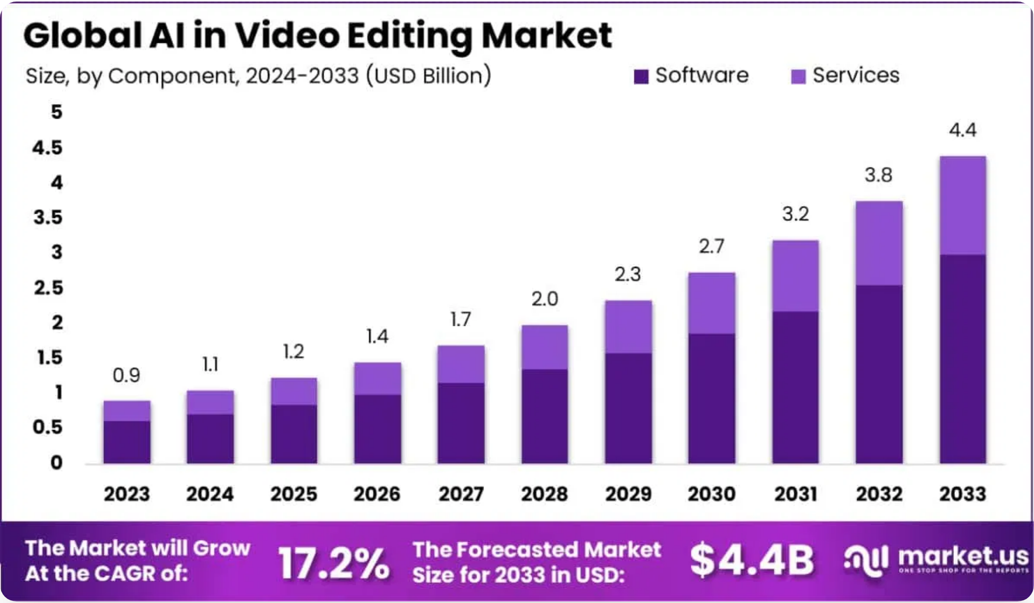



AI Technology
Powered by
Advanced AI
Our proprietary AI stack combines multiple technologies to deliver a seamless editing experience:
Speech Recognition & NLP
Whisper API for accurate transcription and GPT-4 for viral caption generation and styling
AI in Video Editing Market Growth: 17.2% CAGR (2024-2030)
Computer Vision
Custom CoreML models for smart trimming, speaker detection, and content-aware editing
Source: Market.us Research
Generative AI
RunwayML and Replicate APIs for AI avatars, effects, and visual enhancements
Predictive Analytics
Engagement prediction algorithms for optimal publishing times and content optimization
6

Slide 7

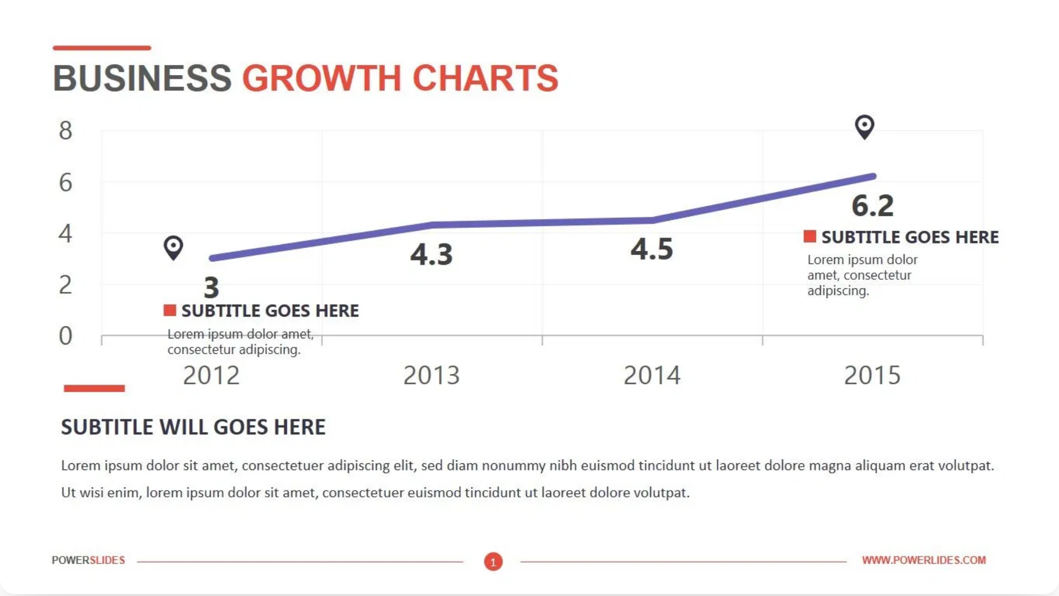



Business Model
Freemium Subscription Model
Projected Growth
Free Tier
3 exports per month
Watermarked videos
Access to 5 basic templates
Basic AI trimming
Pro Subscription
$4.99
/month or
$39.99
/year
Unlimited exports
No watermark
All templates & early access to trends
Revenue Projections
Advanced AI features & custom brand kits
Year 1 Target
Conversion Rate
Monthly Revenue
Year 2 ARR Target
Auto-post scheduling
100,000 active users
8%
$40,000
$1M+
Additional Revenue Streams
In-App Purchases
Premium filter packs, viral caption themes ($1.99-$4.99)
AI Avatar Creator Credits
Generate custom AI avatars for videos
7

Slide 8

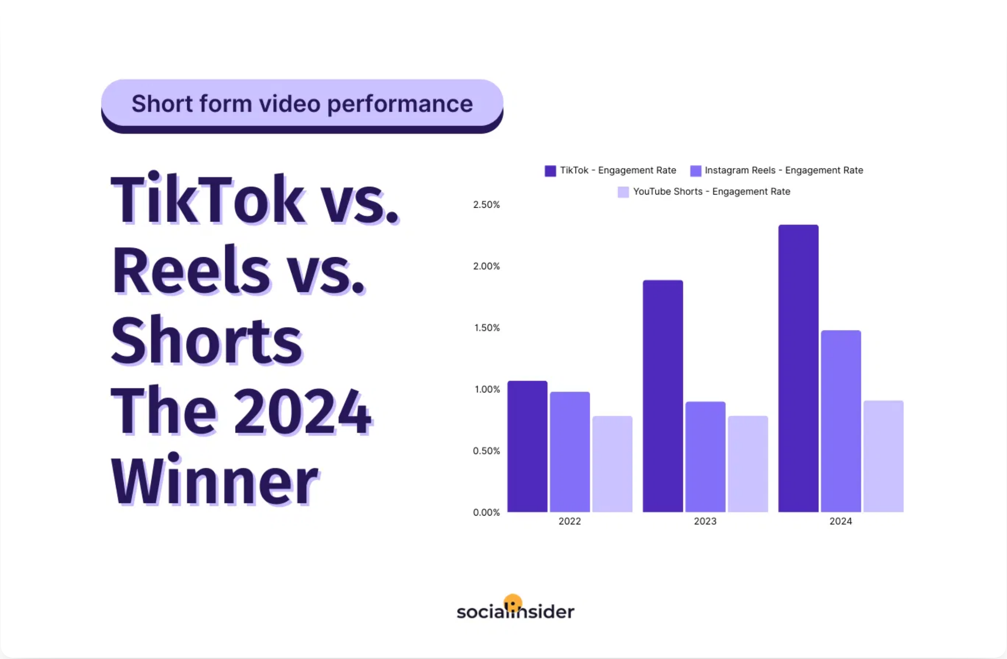




Competitive Landscape
Our
Competitive Edge
While many apps offer basic video editing, SnapEdit AI combines AI-powered automation with viral-optimized templates to create a unique value proposition.
Key Advantages:
AI-First Approach
: Deepest AI integration for
automated editing
Viral Optimization
: Templates designed for
maximum engagement
Speed to Market
: 60-second editing vs. hours with
competitors
Mobile-Native UX
: Designed specifically for
smartphone creators
8

Slide 9



Our Team
A diverse team with expertise in AI, mobile development, and content creation.
CEO & Founder
CTO
Alex Chen
Maya Rodriguez
Former Product Lead at TikTok
Ex-Apple ML Engineer
10+ years in social media product development with expertise in user engagement and growth strategies.
Led AI/ML teams at Apple focusing on computer vision and on-device machine learning for mobile applications.
Head of Product
Growth & Marketing
Jordan Taylor
Zoe Williams
Previously at Adobe Creative Cloud
Former Creator Marketing at Instagram
Specialized in video editing software with deep understanding of creator workflows and UX design.
Expert in creator economy, influencer partnerships, and social media growth strategies.
Advisory Board
We're Hiring!
Industry veterans from
Meta
,
YouTube
, and
Snap
Looking for AI engineers and mobile developers
9

Slide 10

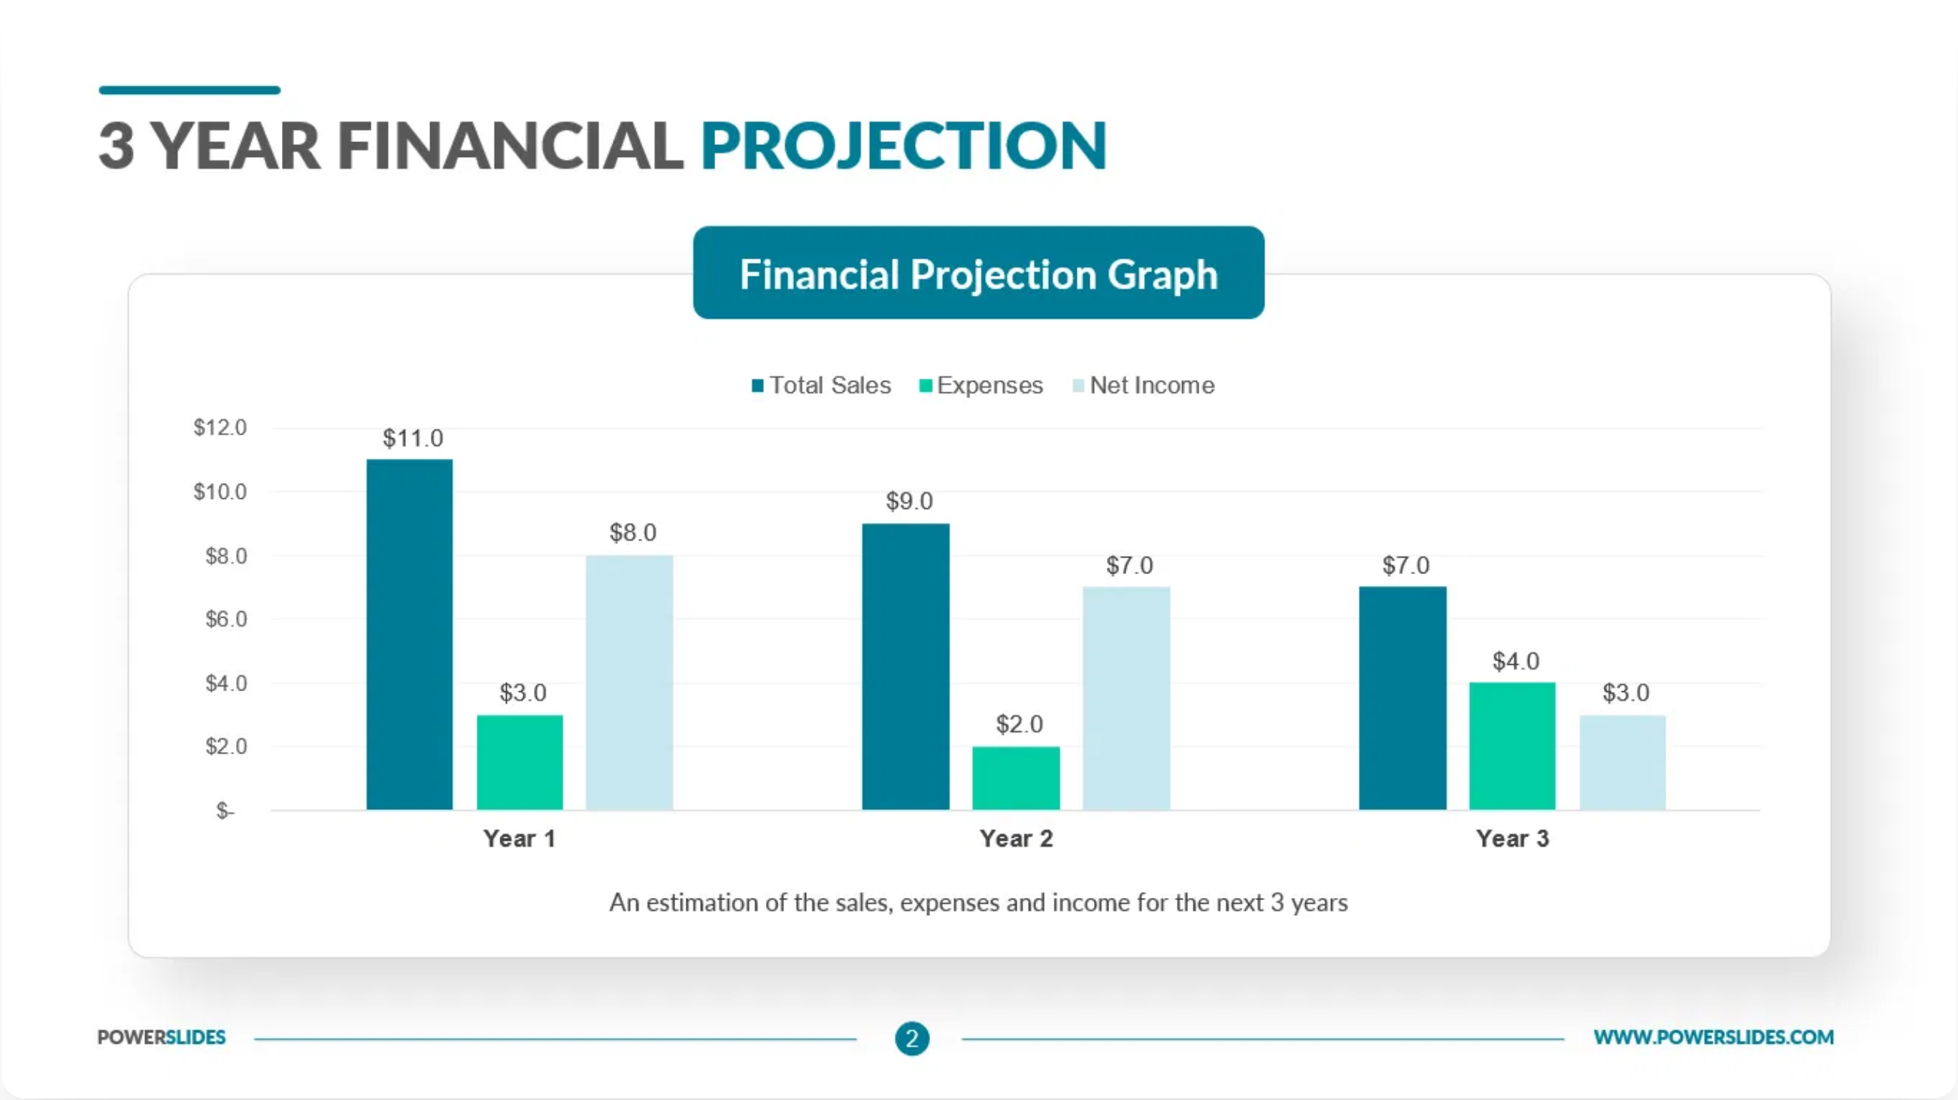


Financial Projections
3-Year
Growth Forecast
Year 1 Revenue
Year 3 Revenue
$480K
$1.8M
User Growth
Year 1
Year 2
Year 3
100K
250K
450K
Key Metrics
Conversion Rate
LTV
CAC
8%
$85
$12
Funding Requirements
Seed Round: $750K
3-Year Financial Projection with Revenue, Expenses, and Profit Margins
For development, marketing, and team expansion
Path to Profitability
Break-even projected by Q4 Year 2
10

